Slide 1
Colleague Engagement Survey: Focus Discussion, #37
December xx, 202x

Slide 2
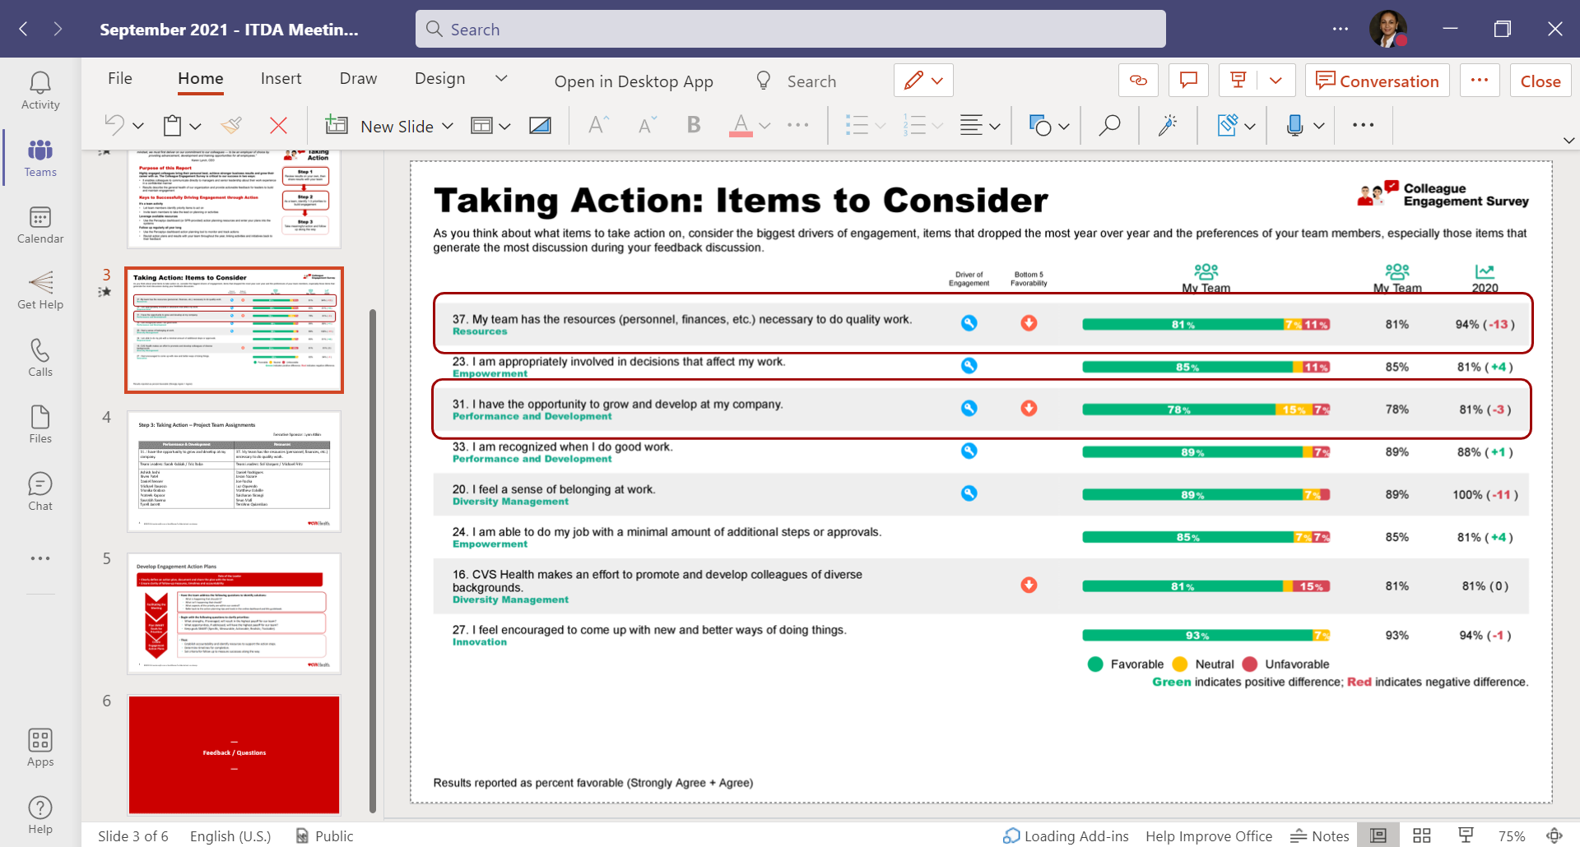
Engagement Survey Results and Action Plans for #37
Development / Training
High-level overview of area under audit, to include DA Team – In progress – DA Workstream, WIT, IT Events (forward invites to DA team)
Effective note taking skills – On Development Plan
Staff Transitions
Create a standardized documentation process for knowledge sharing when someone transfers out of the company/department, and the staff needs to pick up their work to continue the audit efficiently – Template in process
Onboarding
Create a comprehensive plan for onboarding activities (from administrative tasks to learning our audit process), to include list of access that is needed to our share points, tools, sites, etc. - Open to create a checklist; may be a department wide effort
Methodology
Structure process for DA team to engage in an audit from start to end (i.e., gaining an understanding of the IT/Bus. Processes and documentation by attending info gathering w/Audit teams) – In Progress – DA Workstream
Access to Tools and Data
Make a list of tools/data sets that we need access to for just about every audit (i.e., Rally, HR data, Analytic tools, etc.) – In Progress - DA Workstream
Identify which tools we need training on – Department Wide Goals
Conducting lessons learned – We should do this after every project – Template in process
Conduct Audit Staff Evaluations – Share our template and our process using a Teams channel

